Slide 1


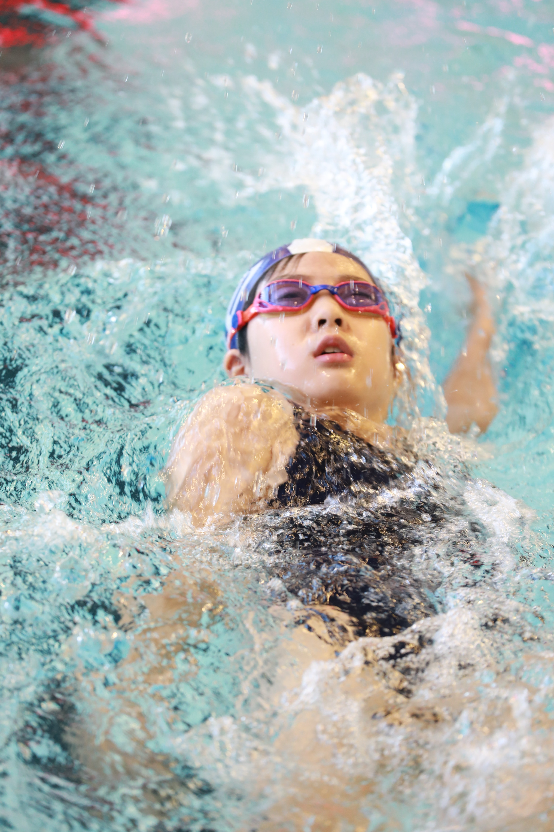
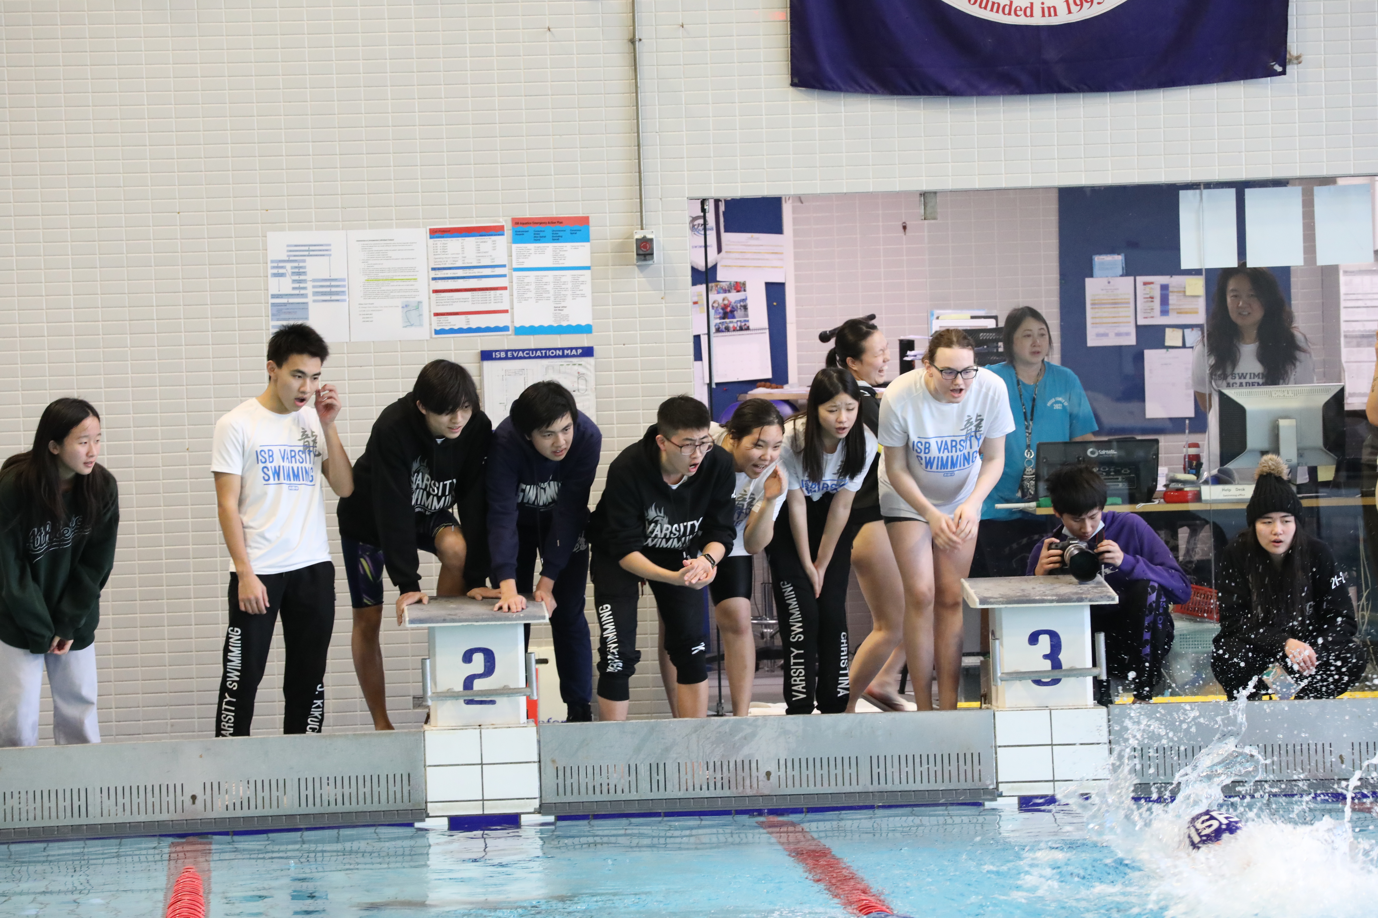
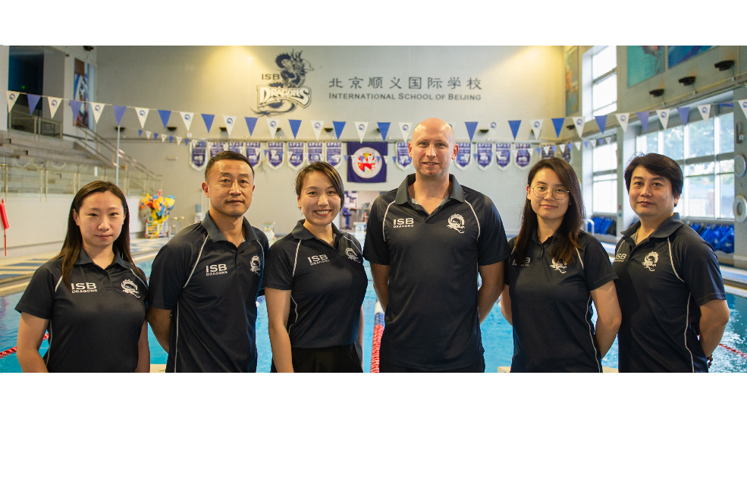
ISB SWIMMING ACADEMY
INFORMATION EVENING
2022-23

Slide 2
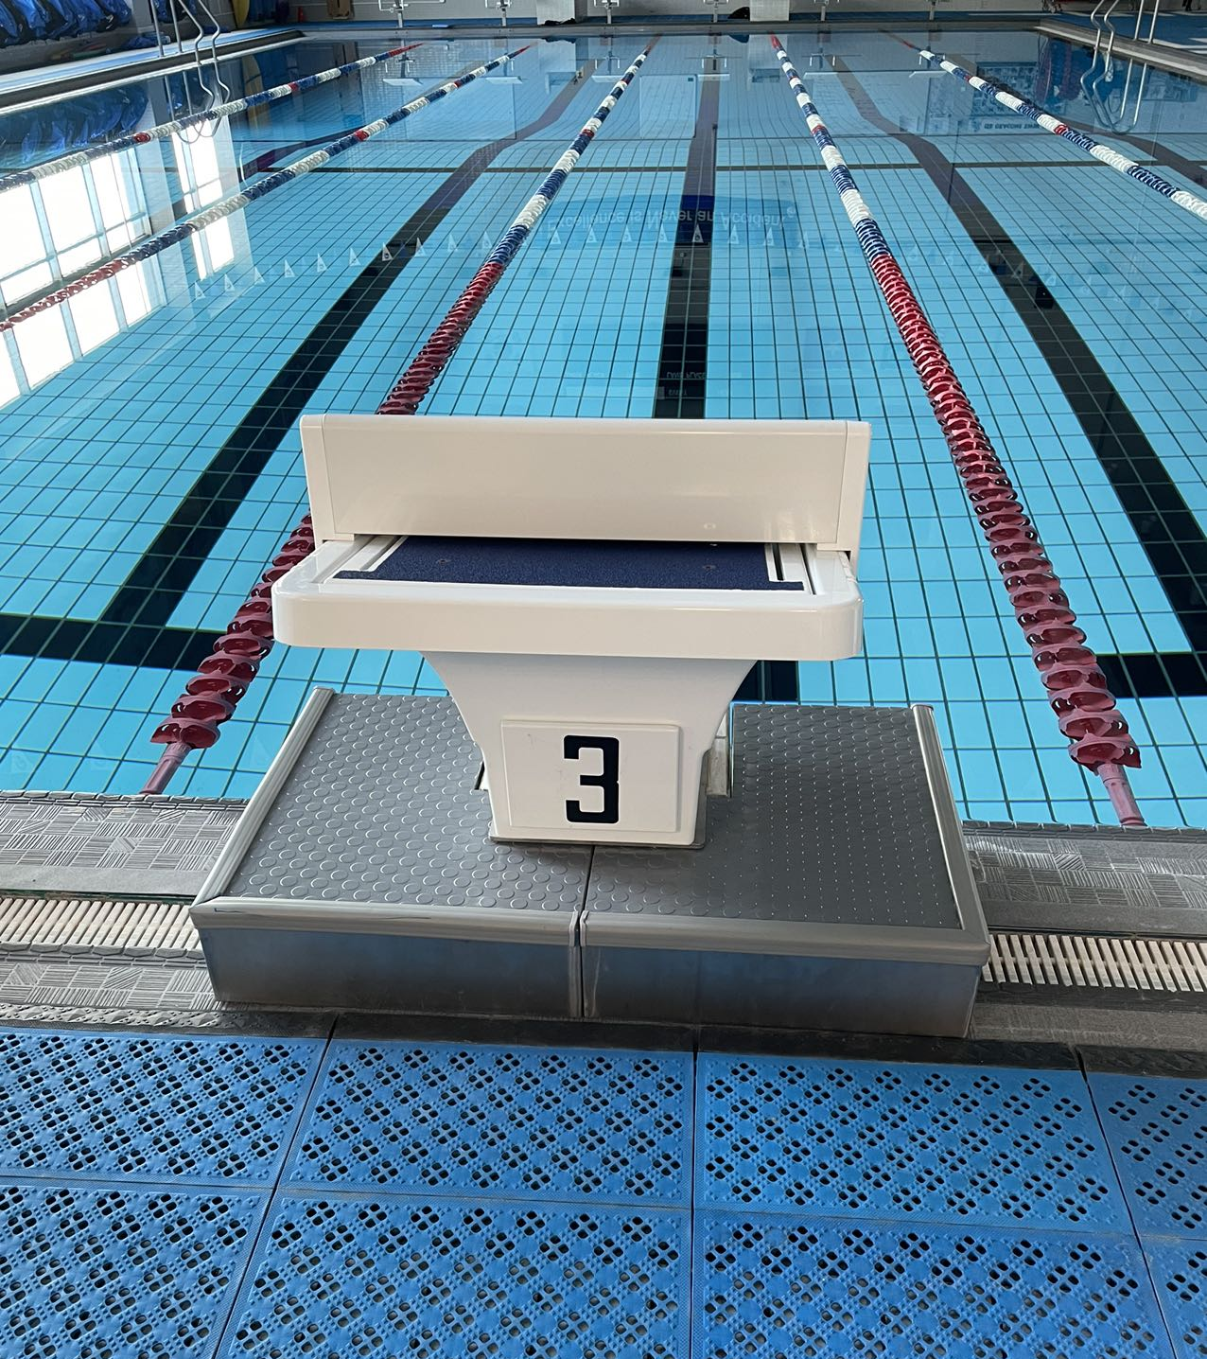
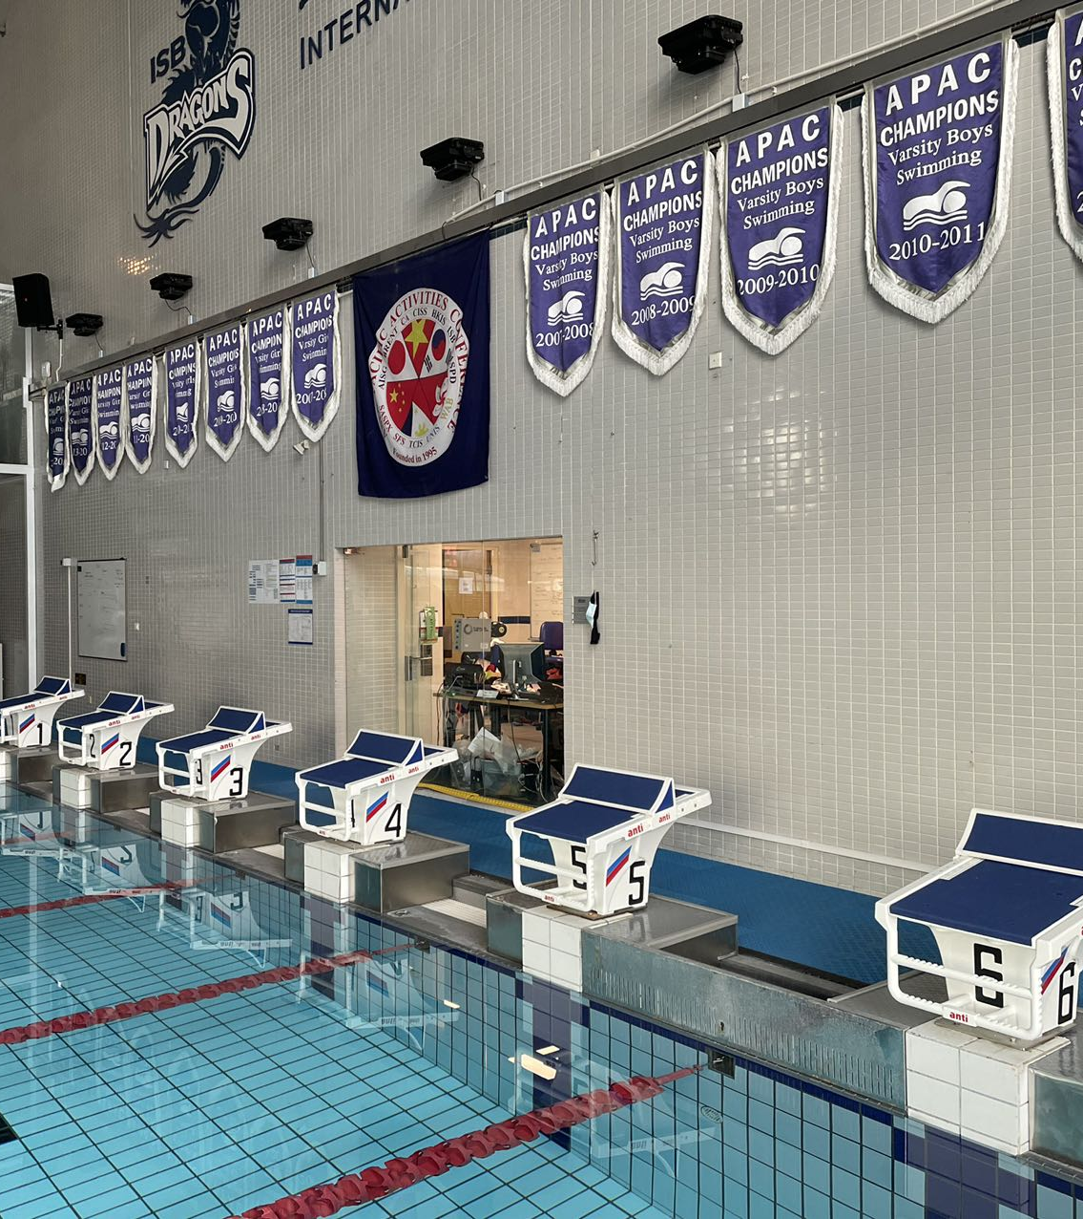
New This Year
NEW DIVING BLOCKS

Slide 3


New This Year
NEW LED SCREEN & TOUCH PADS! COMING SOON IN WINTER 2022-23.

Slide 4
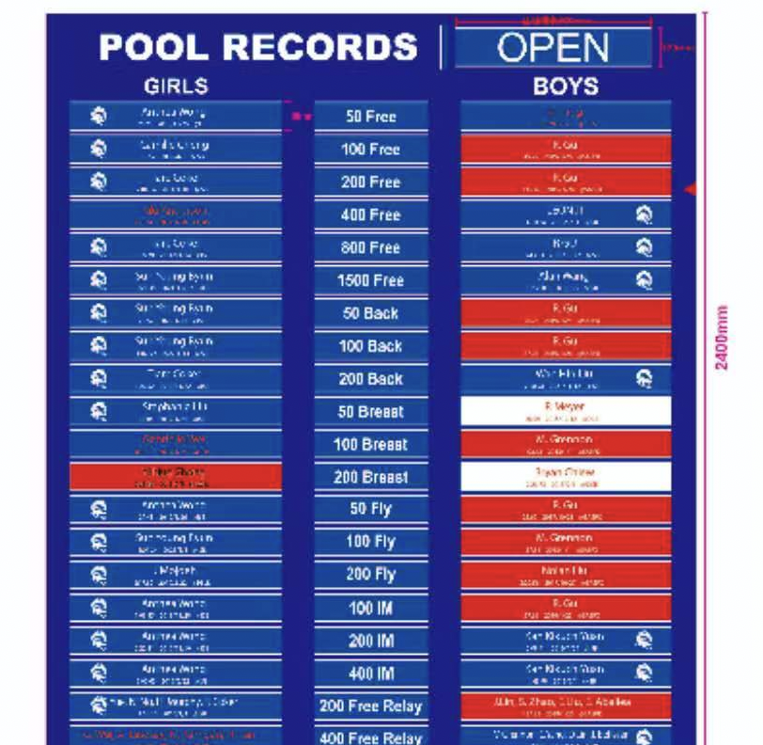
New This Year
Records Boards

Slide 5
New This Year
UES Development Squad (Grade 3-5)
ISAC Meets – Community as well as a Championship event.
Objectives:
Development pathway giving more students to become stroke and competitive ready.
Different level events considering development and Championships at a local level.

Slide 6
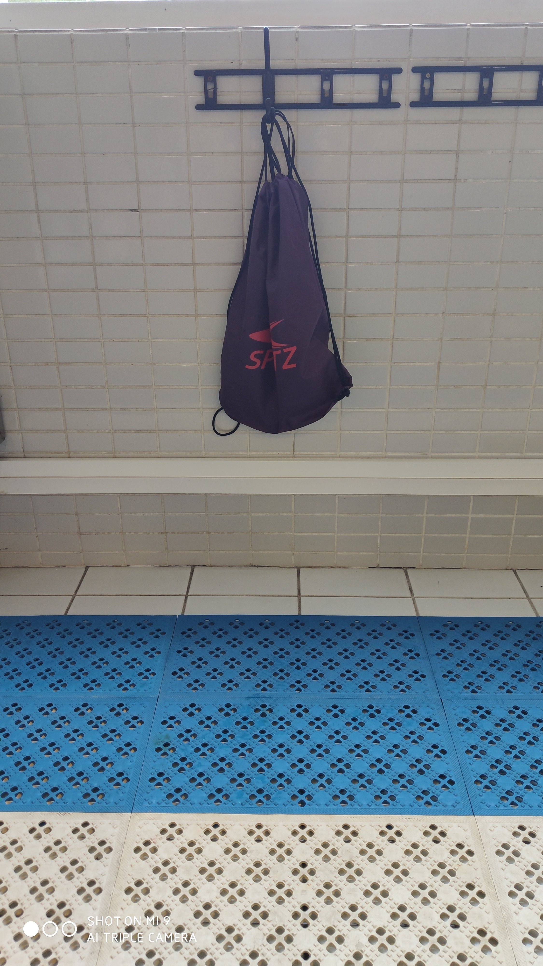
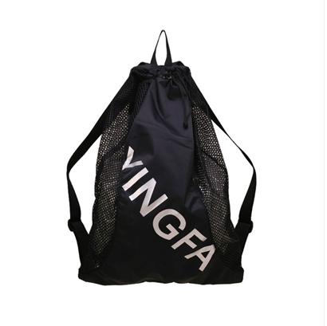
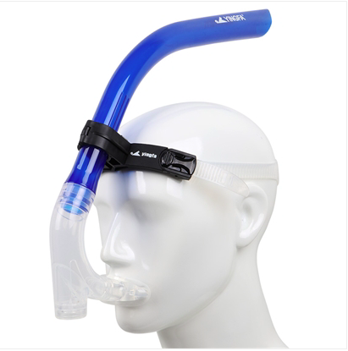
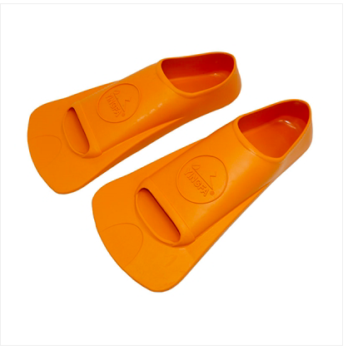
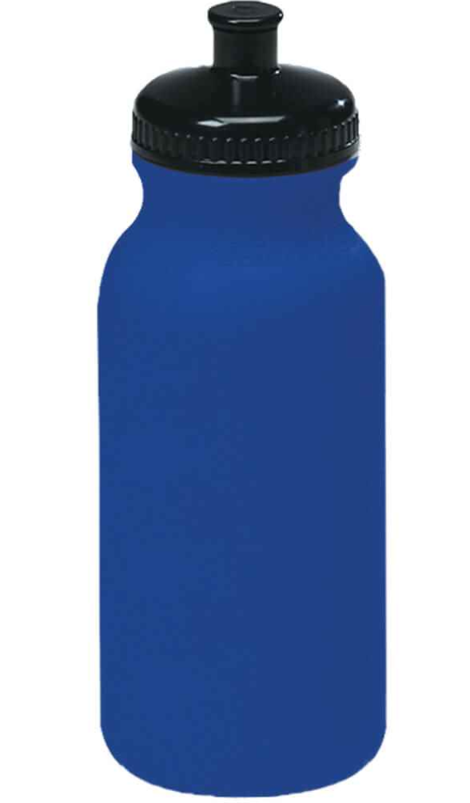
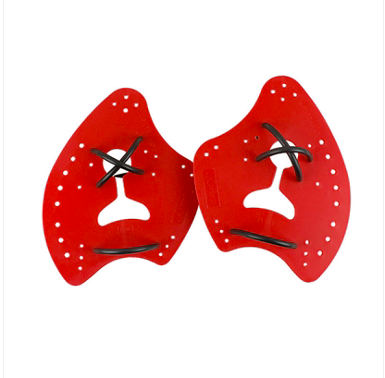
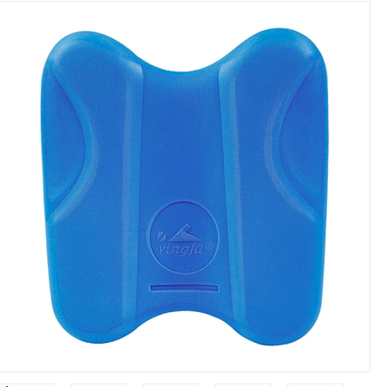
Equipment
New Swimmers will get a bag with the following

Slide 7

Existing Members will have the following trade in items when they are ready. Please email jdeng@isb.bj.edu.cn so we can ensure we order adequate sizes.

Slide 8
Swim Academy Numbers
September 2022
+- 175
+- 30 new swimmers

Slide 9
Aquatics Team
Jenny
Joe
Ariel
Nic
Mona
Arthur

Slide 10
Our Roles
Joe Zheng – Baby Dragons, Little Dragons Silver & Gold
Arthur Wang – ES Blue Squad
Ariel Wu – ES Bronze Squad, Upper-Level Squads and Varsity Girls Head Coach.
Mona – Little Dragons Bronze, MS Blue / Bronze Squad Coach
Jenny Deng – TA / Office Assistant
Nic Wilson – Aquatics Director, UNI / Varsity Boys Squad Coach

Slide 11
Squad Coaches
Coach | LDB | LBS | LDG | ESB | EBR | MSB | MBR | SS | GS | UNI | HSP
Ariel |  |  |  |  | * |  |  | * | * | * | *
Arthur |  |  |  | *
Joe |  | * | *
Mona | * |  |  |  |  | * | *
Nic *Support |  |  |  |  |  |  |  |  | * | * | *

Slide 12
Communications
Nic Wilson – Aquatics Director – nwilson@isb.bj.edu.cn
General enquiries should be sent to jdeng@isb.bj.edu.cn
Squad or Swimmer Related Queries – Applicable Coaches
Joe Zheng – wgzheng@isb.bj.edu.cn
Arthur Wang - awang@isb.bj.edu.cn
Mona Tao – mtao@isb.bj.edu.cn
Ariel Wu – awu@isb.bj.edu.cn
WECHAT – This is not our official communication channel.

Slide 13
Activities Department Team Support
Simon Parker – Activities Director - sparker@isb.bj.edu.cn
Randen Morisako – Strength and Conditioning – rmorisako@isb.bj.edu.cn

Slide 14
Volunteer Committee Team
Volunteer Overseer – Jenny Deng
Volunteer Co-Ordinator – Camilla
Team Manager / Meet Manager Tech Support – Sarah Hu leading her team of (Anna, Tina, Avina, Chloe and Celina)
Team Photographer’s – Frances
Starter Team – Eric, supported by his team.
Swim Academy Event Planner – Can

Slide 15
Positions Needed 2021-22
Photography Team – Please enquire to Coach Nic if you are interested.
Systems Team – Training required. Please connect with Coach Nic for more information.
Starter Team - Training required. Please connect with Coach Nic for more information.

Slide 16
Want to get more involved?
Systems Training @ Swimming Pool
Tuesday 11th October – 12 – 1pm
Starter Training @ Swimming Pool
Thursday 13th October – 12 – 1pm
*Please contact Jenny jdeng@isb.bj.edu.cn if you would like to sign up. BOOKINGS ARE ESSENTIAL FOR ENTRY INTO CAMPUS

Slide 17
Equipment Size Checking
Clothing and Swimsuits
Rocket Science have a guide. They will except re-call or changes in sizes if incorrect.
Finz Sizing
Jenny will have a desk oustide the swimming pool next week - Monday, Tuesday, Wednesday, Thursday 3:40pm until 4:10pm. Swimmers can try on finz sizes then.

Slide 18
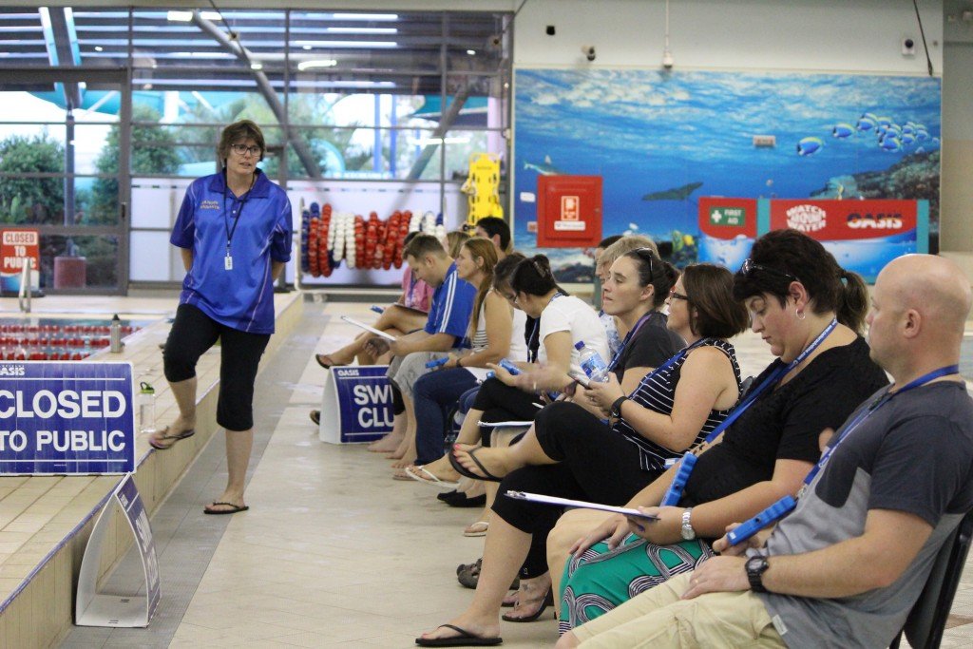
Parent Volunteering – If parents allowed on campus..
2 meets a year per child
Sign-up Online through Team Unify

Slide 19
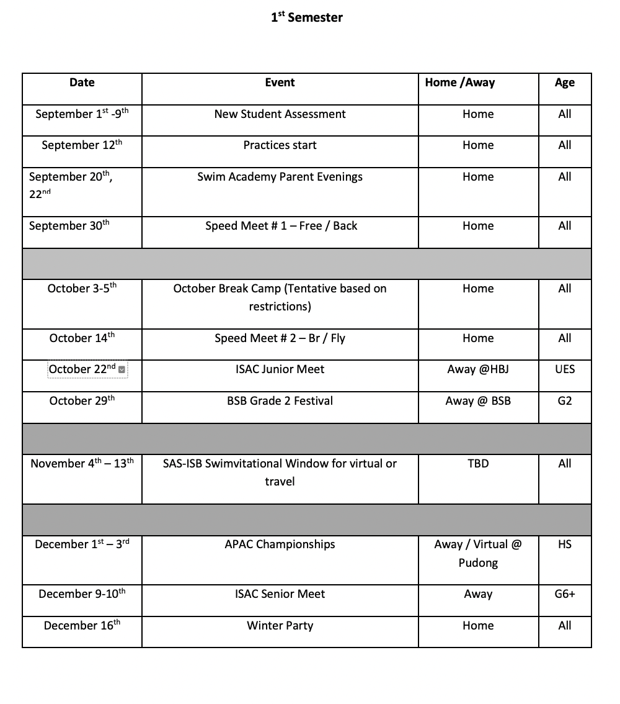
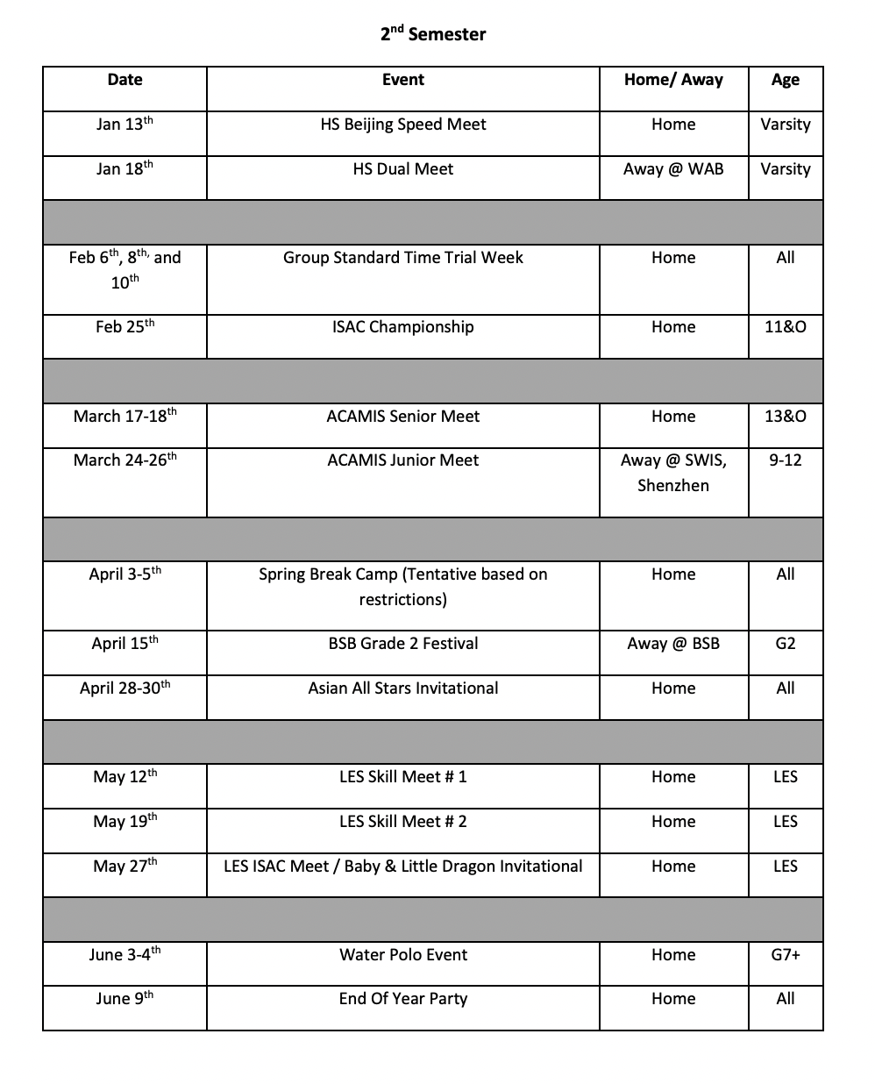
Calendar

Slide 20
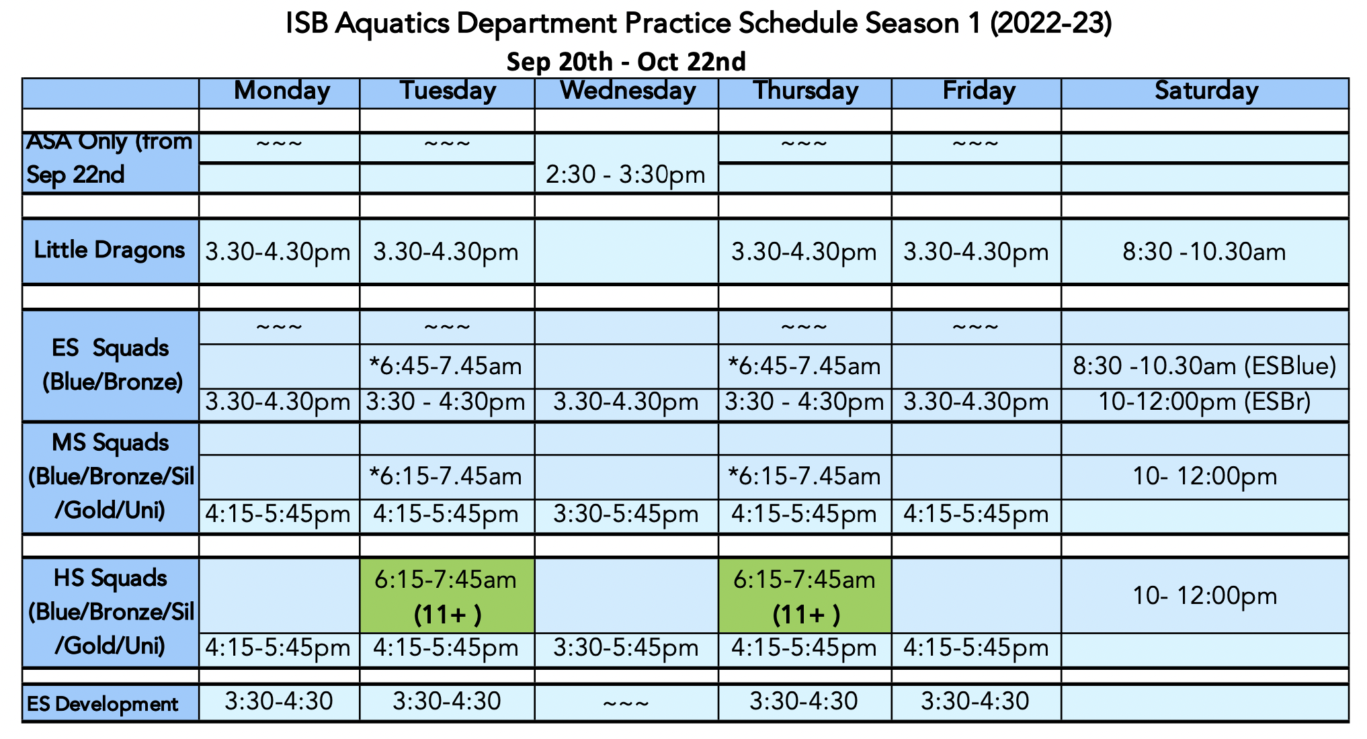
Academy Session 1

Slide 21
Schedule Reminders
3:35pm - ES swimmers should be diving in
4:15pm - MS / HS swimmers should be on deck for a stretch and limber.
Wednesday Practice times
3:30 – 4:30 – ES Blue and Bronze (Private Transport)
3:45 – 5:45 – Early session start for MS / HS

Slide 22
Tech Lane
Every Wednesday 3:30 – 4:30pm
Rotation of tech lane throughout the year
MS – From October – Middle Nov
HS – From Nov - Jan
ES from January – End April
HS, MS, ES rotation every week until the year end.

Slide 23
ISB’s Long Term Athletic Development
University Squad – NCAA BEYOND
Silver Squad 2 practices
TRAIN TO COMPETE
Little Dragons – 2 practices
FUNDAMENTALS
Bronze Squad 2 practices LEARNING TO TRAIN
Blue Squad – 2 Practices
LEARNING TO PRACTICE SKILLS
Gold Squad 2 practices TRAIN TO WIN
IM Focused
Technique

Slide 24
How Many Practices Should my child be doing?
Rough Guide – Age divided by 2 minus 1
7-8 – 3 Practices a week
9-10 – 4 practices a week
11-12 – 5 practices a week
13-14 – 6 practices a week
15 & O – 7 – 8 practices a week
Multi Sport Athletes are recommended to stick to our minimum attendance due to other sport commitments.
HS Pre-Season Athletes have more flex options depending on academics and other season sports. TBD

Slide 25
Attendance
Academy Swimmers – 2 practices a week for all squads this season.
High school season swimmers – 3 practices a week.
What if swimmers don’t attend?
There will be 2 Gentle Reminders.
3rd offence will mean swimmers miss either a swim meet or a relay position in the A or B relay team at the next meet.
In season attendance may affect being selected for certain events.

Slide 26
How will we take attendance this year?
Attendance starts from 26th of September.
ES will be ticked off on a squad roster. Weekly messages on your child's attendance will be mailed to everyone.
MS / HS will sign in with a QR code at the front entrance to the pool. They can sign in with their own device, or with the Ipad provided.
Please indicate your attendance in the applicable section in the handbook.
Permanent changes of schedule - please e-mail jdeng@isb.bj.edu.cn to change this on the system.

Slide 27
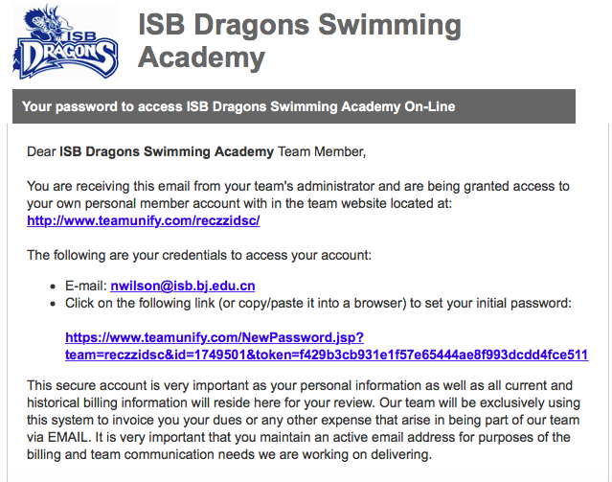
Steps To Follow When in the Team
STEP 1 - Team Unify Log-in. If you do not receive this e-mail before the weekend, please contact Jenny Deng on Monday next week.

Slide 28
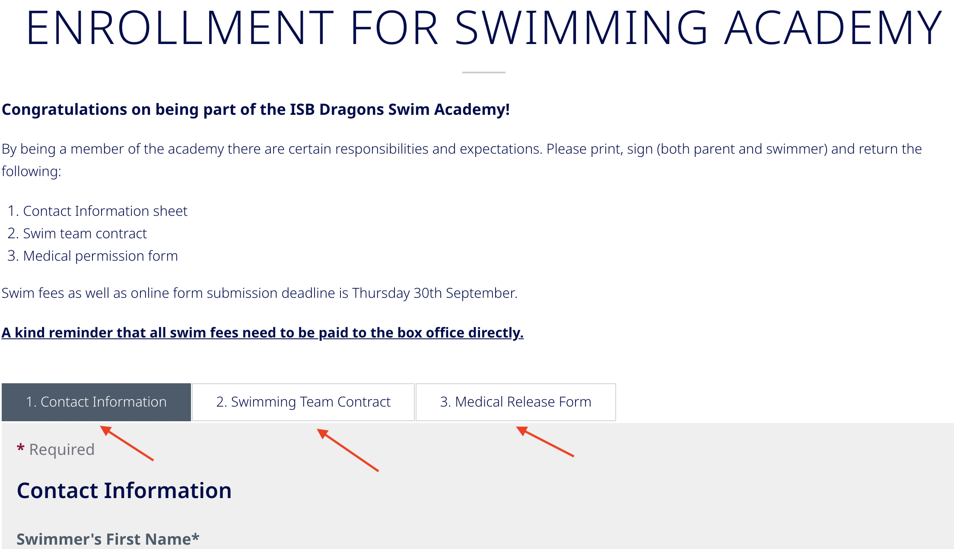
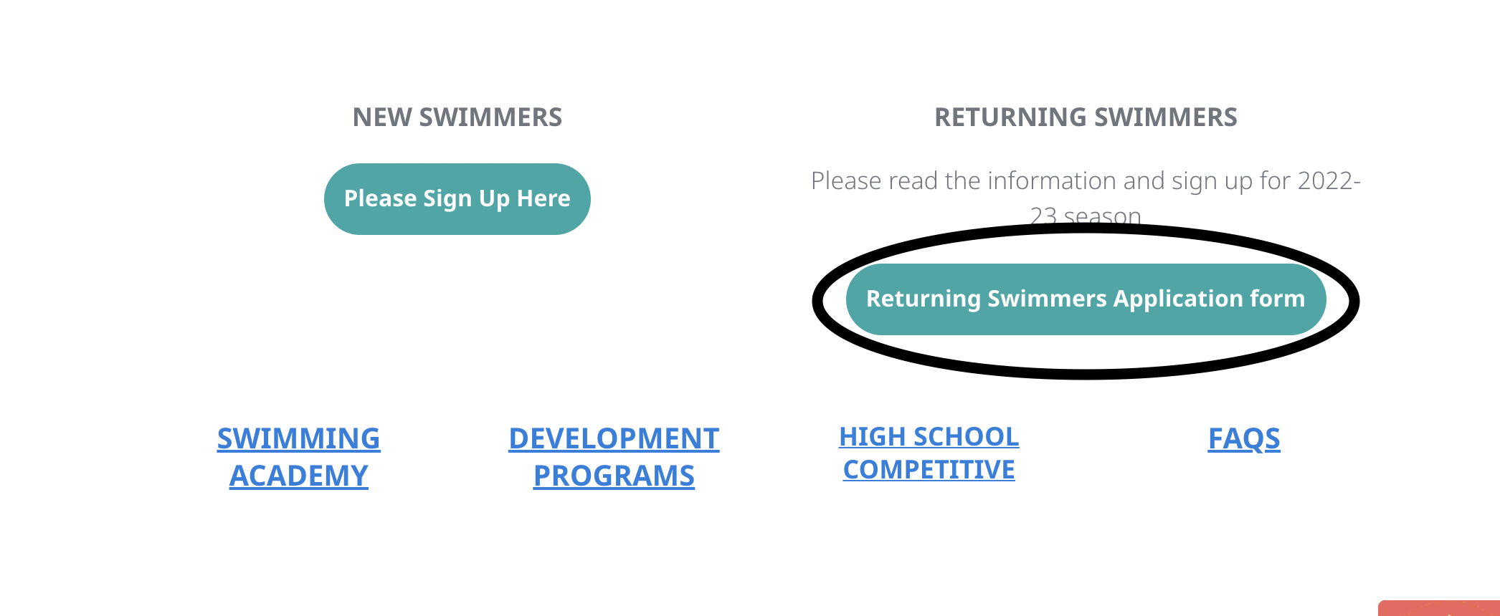
Steps to Follow When in the Team
STEP 2 – Fill in the forms on the dragon's gate site under co-curricular, aquatics. To find these forms push the button – returning swimmers. Then follow and fill the forms in online.

Slide 29
Steps to Follow When in the Team
STEP 3 – If new to the team Pay applicable fees at the Box office 2nd floor in the business office. DEADLINE – 30th September
Younger ES parents can ask TA’s in their home room to support the delivery of money to box office.
Send only money to the box office in an envelope with First Name, Last Name, Squad and Swimming academy fees written onto it.
Step 4 - Once payment is made swimmers can then obtain their caps and equipment for the year.

Slide 30
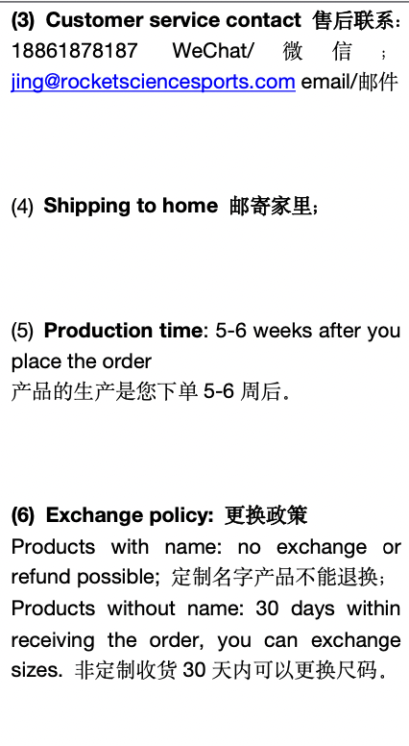

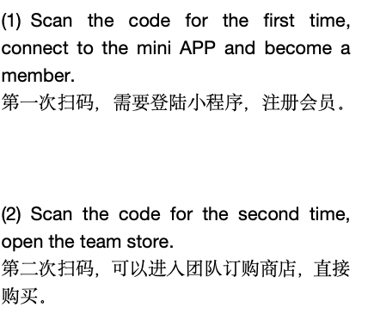
Steps to follow to order the uniform

Slide 31
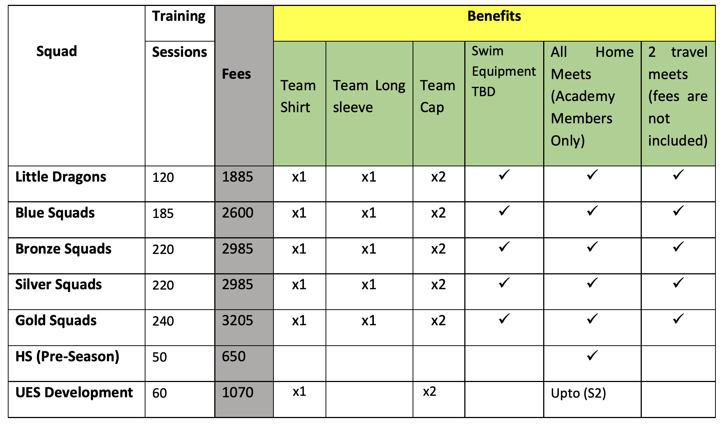
Fee Structures
2021-22 team members do not have to pay fees for semester 1. Semester 2 will be under review based on how the year evolves with restrictions.
New Members pay fees as follows:
This is also found in the handbook.

Slide 32
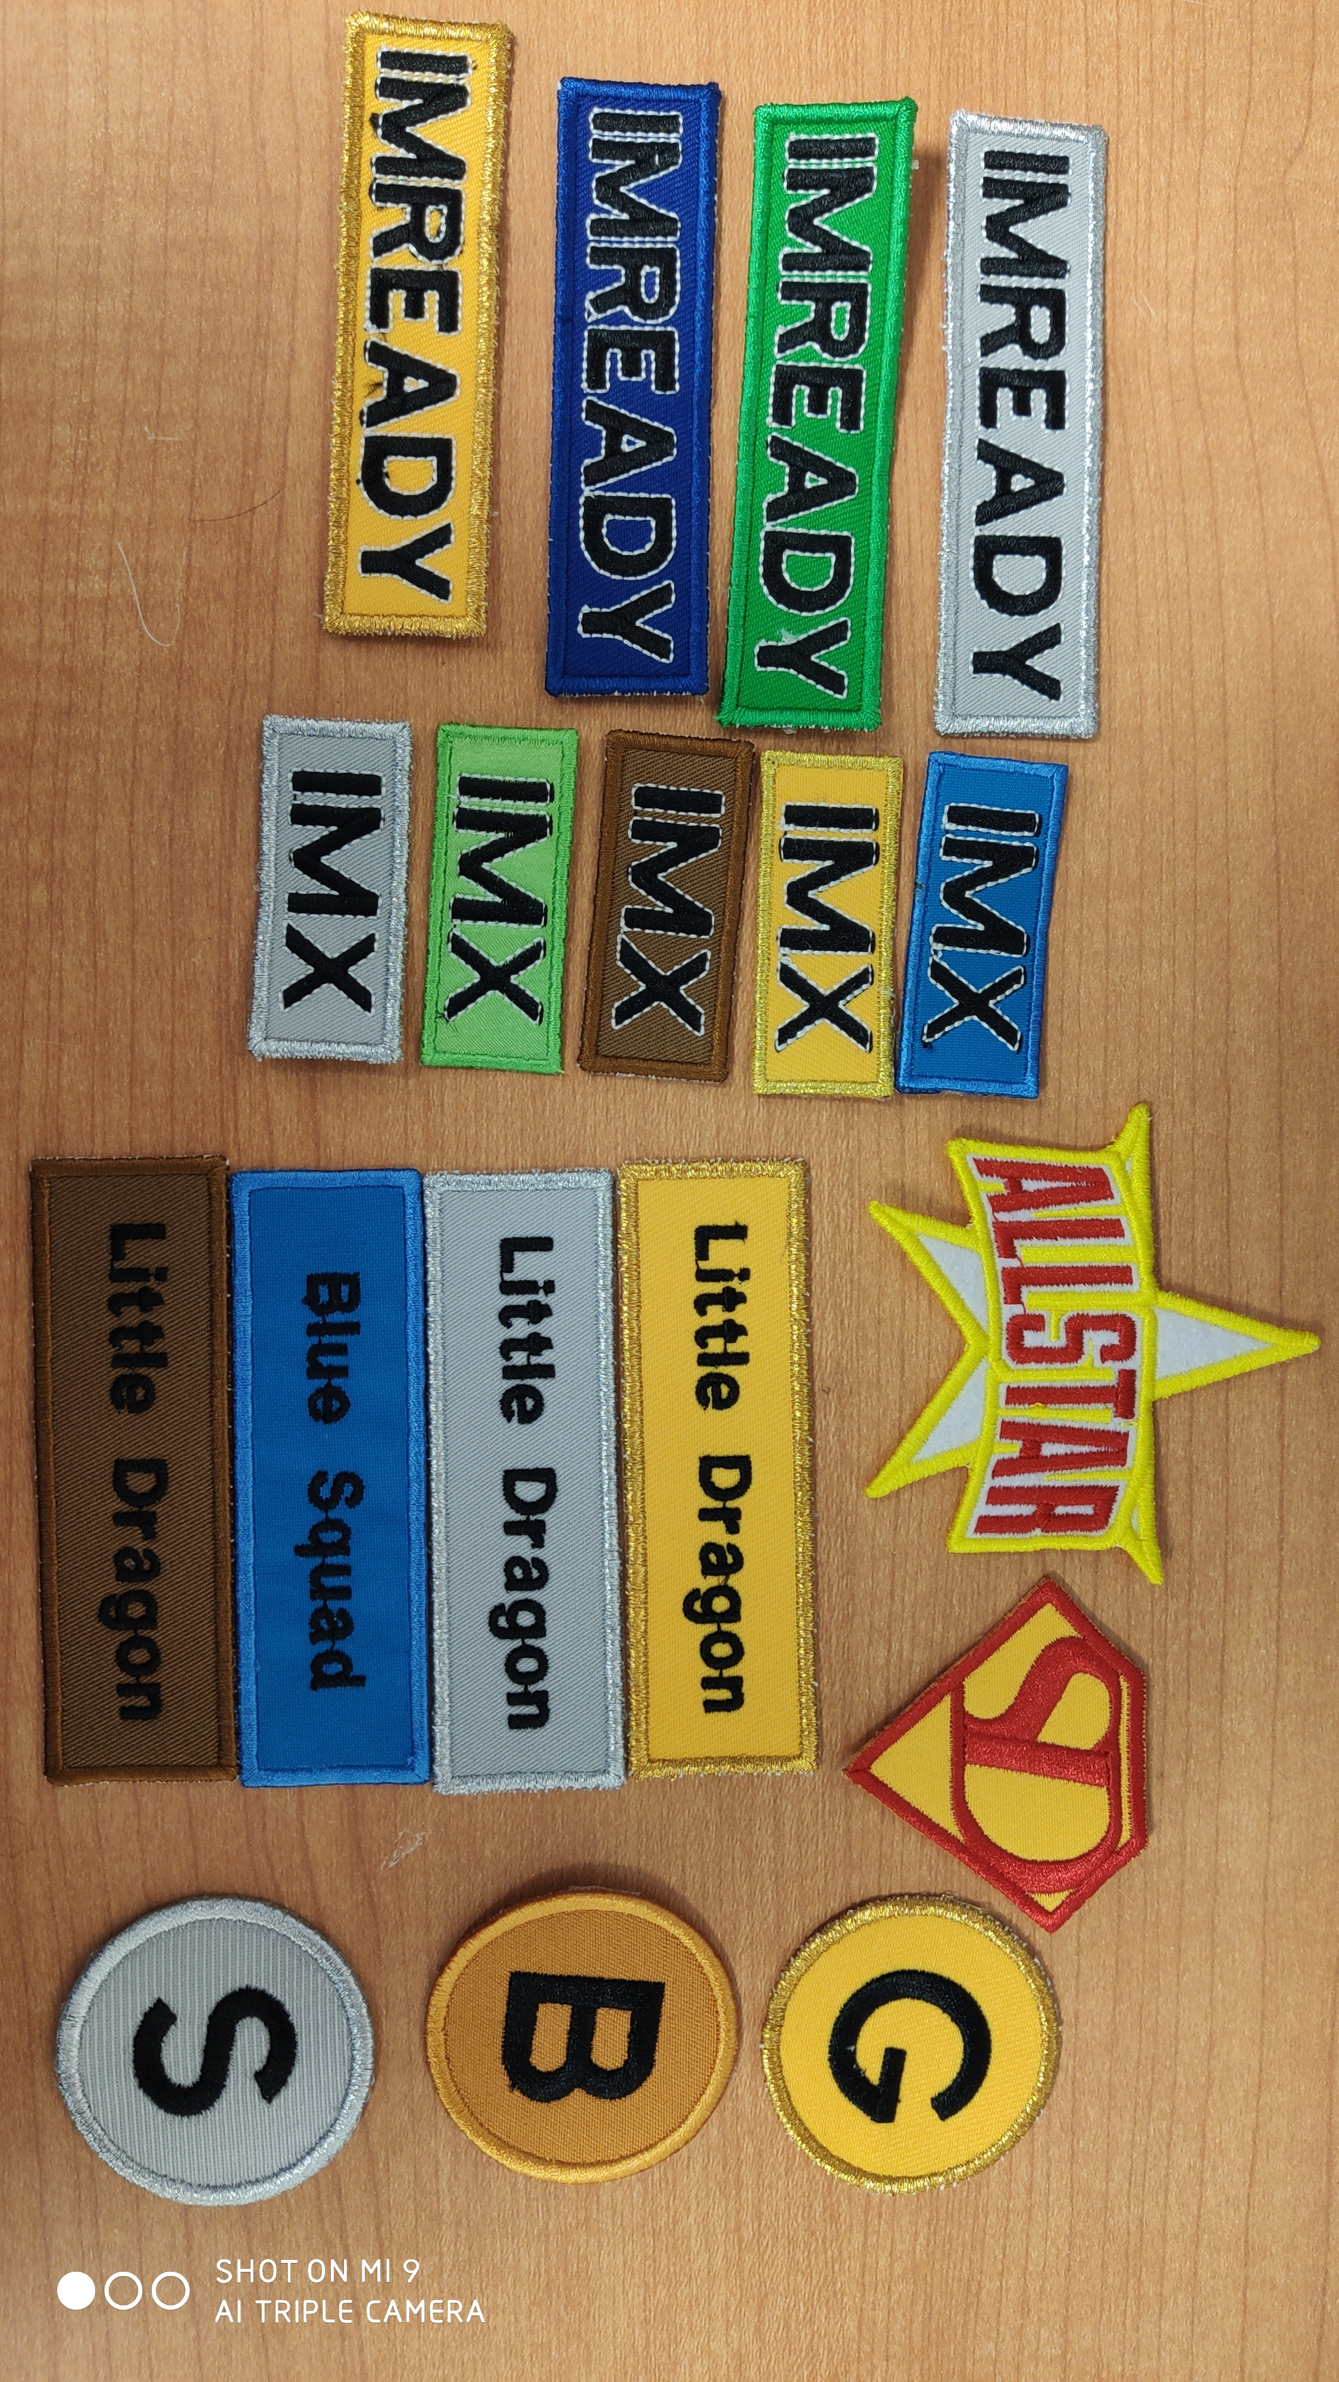
What else do the fees cover?
ISB Award Scheme
Winter Party & End Of Year Party
Access to the Team Unify Website
End of year tags
Equipment and or trade-ins

Slide 33
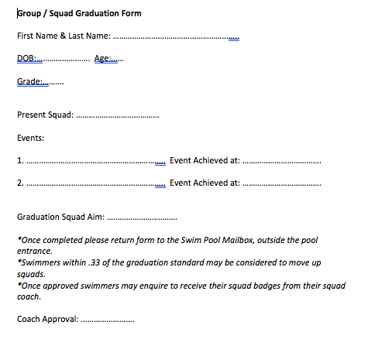
Award Scheme - Graduation Badges
How to receive Graduation Badges
Find this form on our documents page – Team Unify

Slide 34
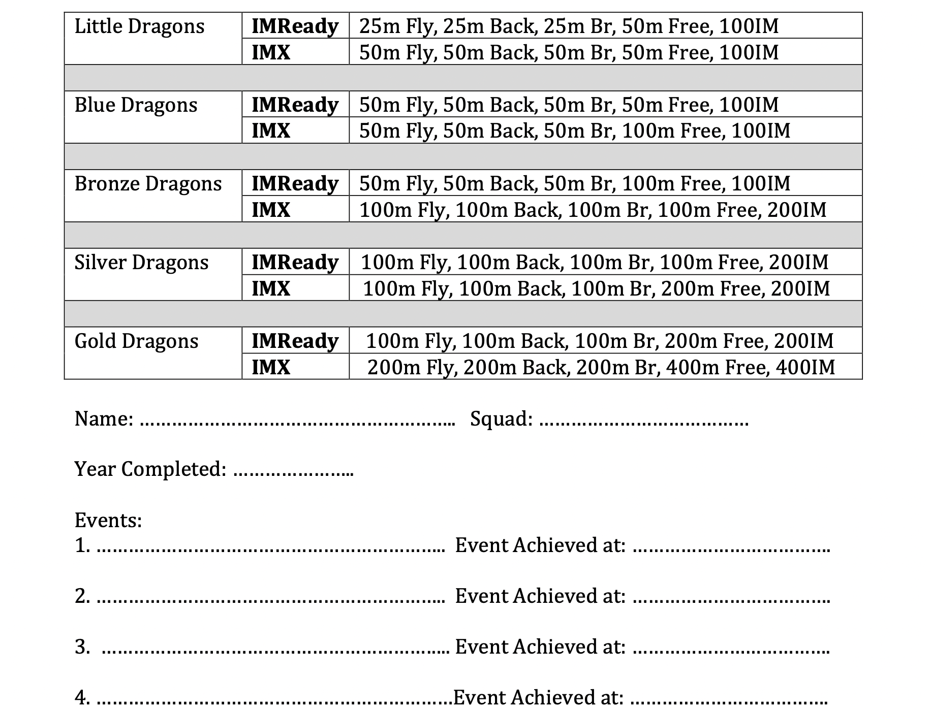
Award Scheme – IMX and IM Ready

Slide 35
How we communicate - Team Unify
Sign Up Via Team Unify E-mail
Add as much Information on your profile – photo.
View Help Tutorials
Seek our Help – jdeng@isb.bj.edu.cn
Sign-up for volunteering at meets – Tutorials will help.
Viewing swimmer information.

Slide 36
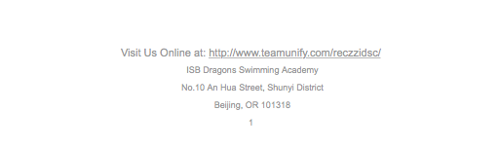
Logging Into Team Unify Site
Find the URL at the bottom of our e-mails.
Save and Bookmark the page on your browser.

Slide 37
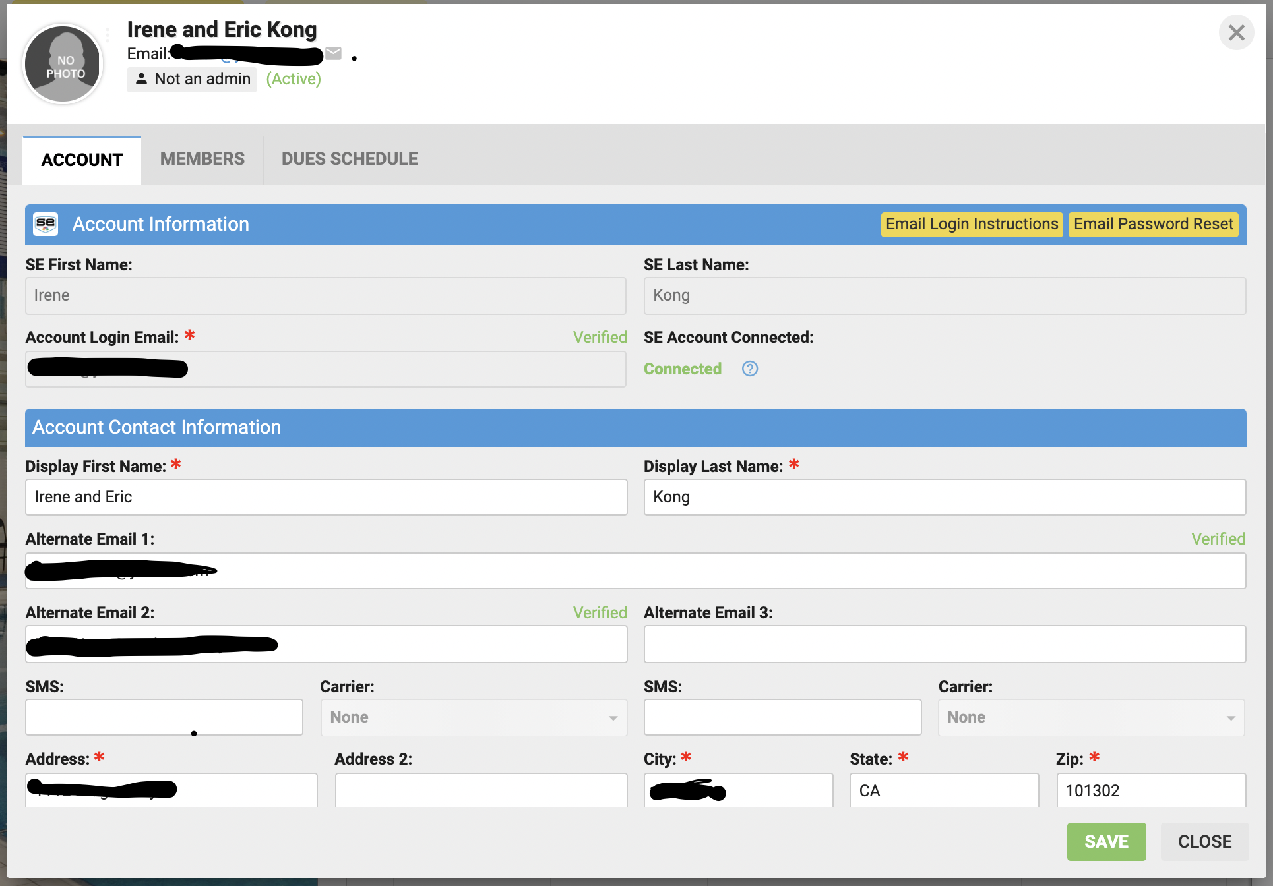
My Account

Slide 38
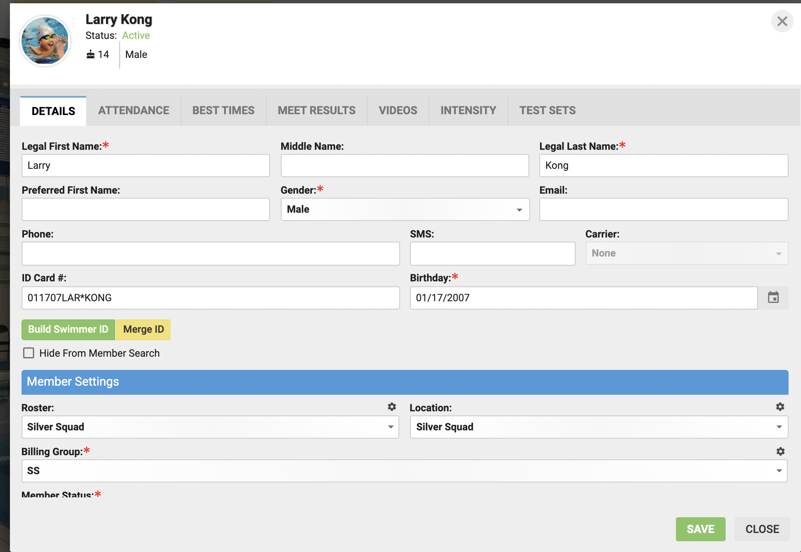
Member Profile

Slide 39
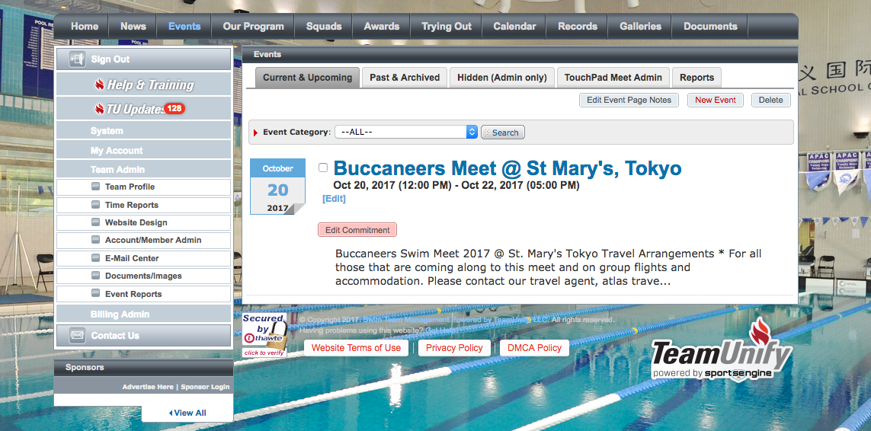
Signing Up For Meets

Slide 40
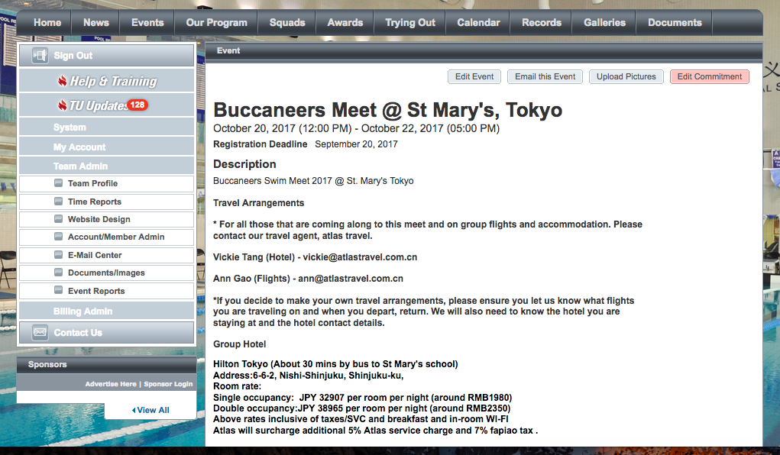
Signing Up For Meets

Slide 41
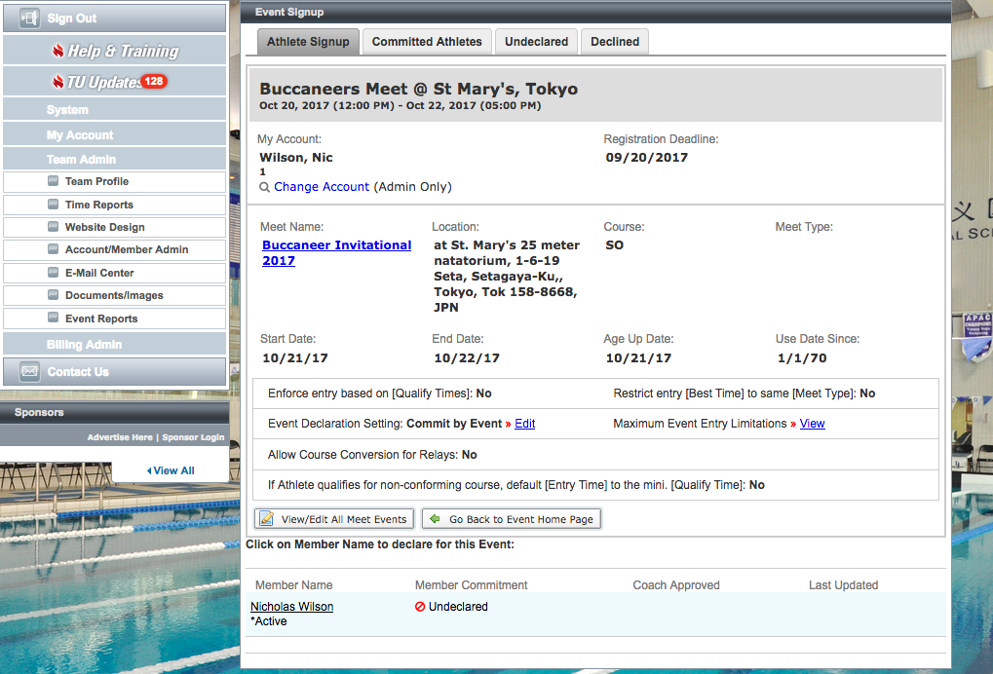
Signing Up For Meets

Slide 42
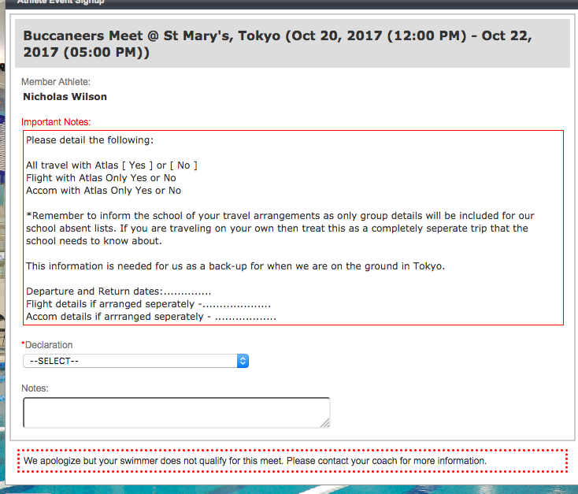
Signing Up For Meets

Slide 43
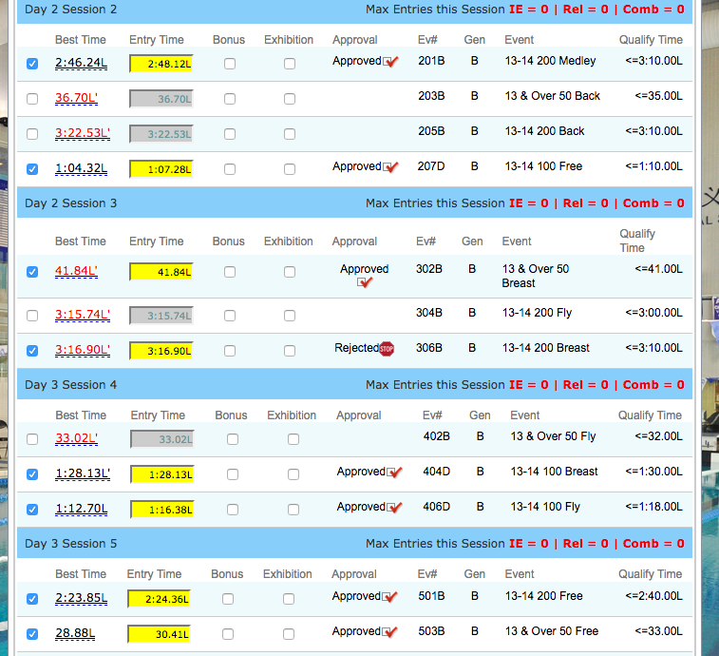
Signing Up For Meets
*Please ensure swimmers qualify

Slide 44
What if Team Unify cant be accessed?
Try loading the site while using a VPN
Please email us and we will try and help.
We will have a back-up system on powerschool for all information if team unify is down for some reason.
We are also looking into a back-up generic form on dragon's gate which can be accessed if we need it for when we sign up for meets and volunteering.

Slide 45
Reminders for swimmers at meets
Check in by finding your name on the meet check-in sheets.
No towels are provided at swim meets
No Food On Deck
Clean Up Pool Deck
Quiet at the start of races.
Listen to marshals when calling out names.
Exit out the sides, not over touch pads.
Listen to the volunteers for over the top or exiting the pool guidance.

Slide 46
Goals for the Academy this Year..
ISB DRAGON CORE SPORTING VALUES
COMMITMENT – RESPECT – FUN
Attendance – Child-safeguarding
IM Integration as per the LTAD ethos
Continue to grow and foster team spirit.
Dry-land Integration
TECH LANE as a tool for coaches and swimmers.
Maintenance of Average 80 % PB Tracking

Slide 47
How Can Families Help Foster Team Spirit?
Volunteering at Meets. Best seat in the house often! ☺ Your children love to see you involved and we become a closer swim family.
Set-up opportunities for swimmers to socialize and have fun outside pool practice.
Support personal goals but also aim to contribute to ISB team goals.
Help to reinforce International Best Fair Play Rules – One team only for competing.
Promoting coach / swimmer relationship building. Pre-race chats and feedback at meets.
Promote ISB first, and if you have to choose providers to help support ISB’s goals.
Help us to celebrate skill acquisition and technique improvements in combination with time improvements, rather than just on time drops and or placing alone.
Work in partnership with ISB to help your children reach their full potential.

Slide 48
Things for Swimmers to be mindful of….
Am I attending my minimum practices?
Am I on time to my practices?
Am I developing a relationship with my coach to reach my personal and team goals?
Am I a good sport, win or lose?
Do I meet with my coach before and after swimming in races?
Am I contributing to team goals as well as working on individual ones?

Slide 49
We look forward to a wonderful year.
Any Questions?

